Slide 1
Fashioning Models from Fashion Models
A study of color from the most visible fashion events
By Frank Turner

Slide 2
Problem Statement
Fashion is a $3 Trillion industry
Trends are set by fashion elite
Being able to identify trends quickly and cheaply can be valuable in:
Retail: identify what’s next
Fast Fashion: decide what to make next
Other designers, know who follows who

Slide 3
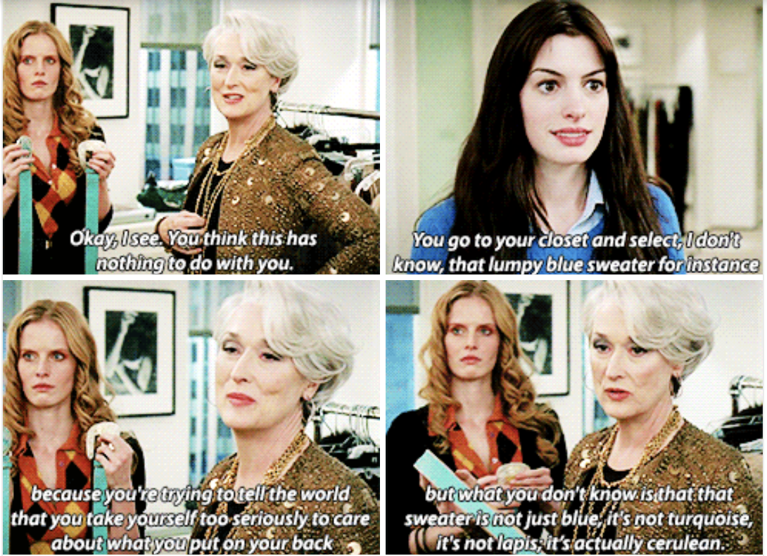
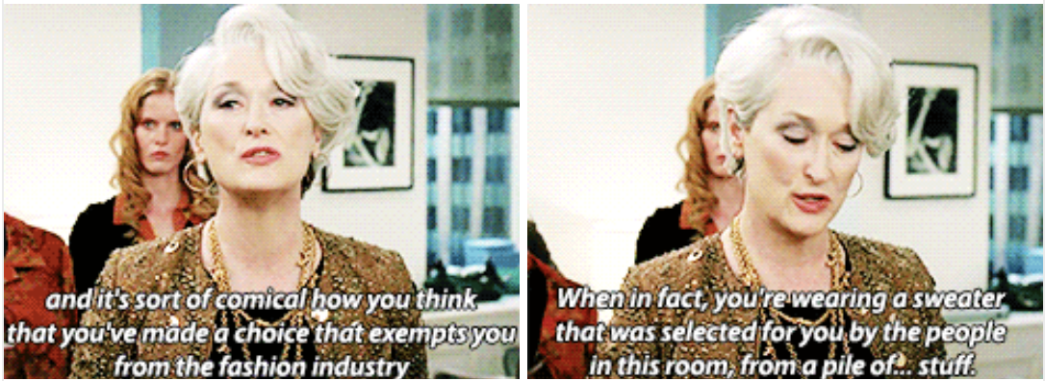
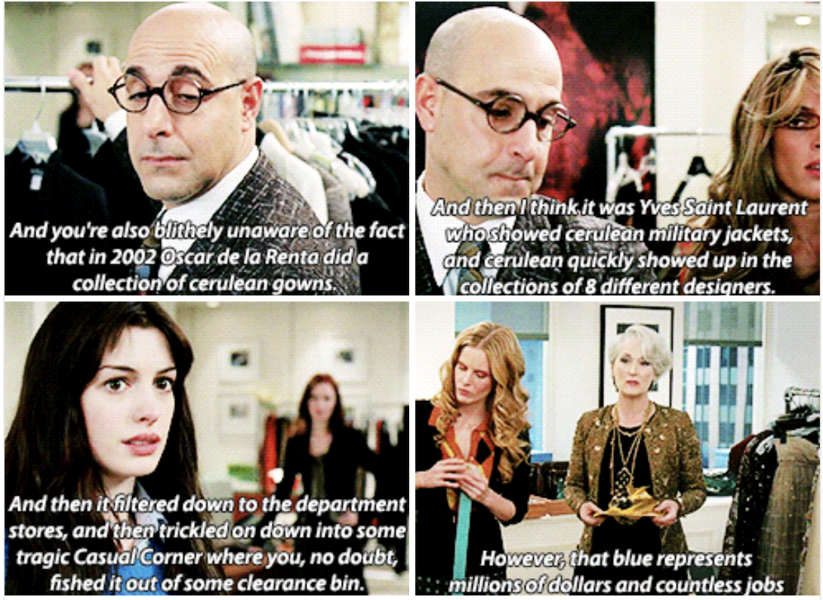
Like it or not – Fashion Affects you
Notes:
https://www.youtube.com/watch?v=vL-KQij0I8I

Slide 4
Scope of Project
Images Scraped from Vogue.com
Every catwalk event labeled 2015-2019
Over 1400 images, 235 fashion shows
Only Top Designers

Slide 5



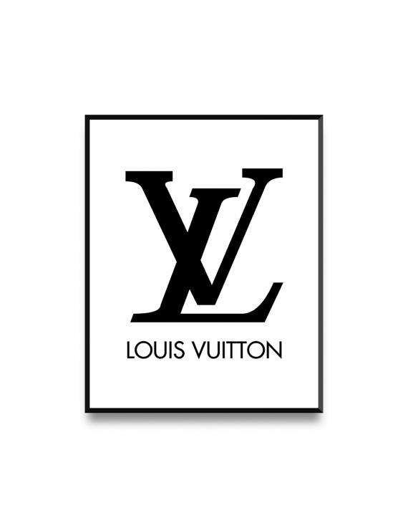



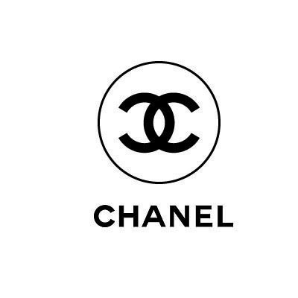
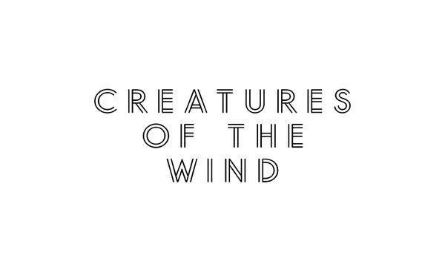


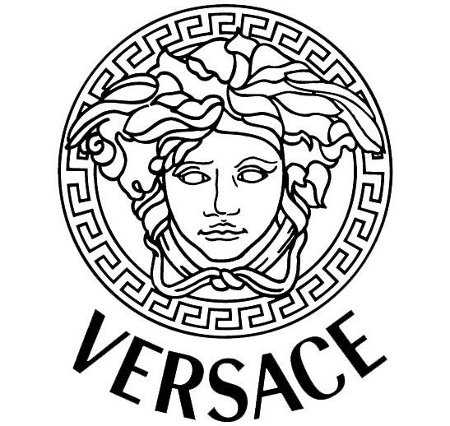








Designers in the Data Set

Slide 6
Prepocessing
Tensorflow to isolate models
Canny Edge detection to remove remaining background
K-Means Clustering to group colors
Pythagrean Theorem to map clusters to nearest defined color in predefined “bag-of-colors”

Slide 7
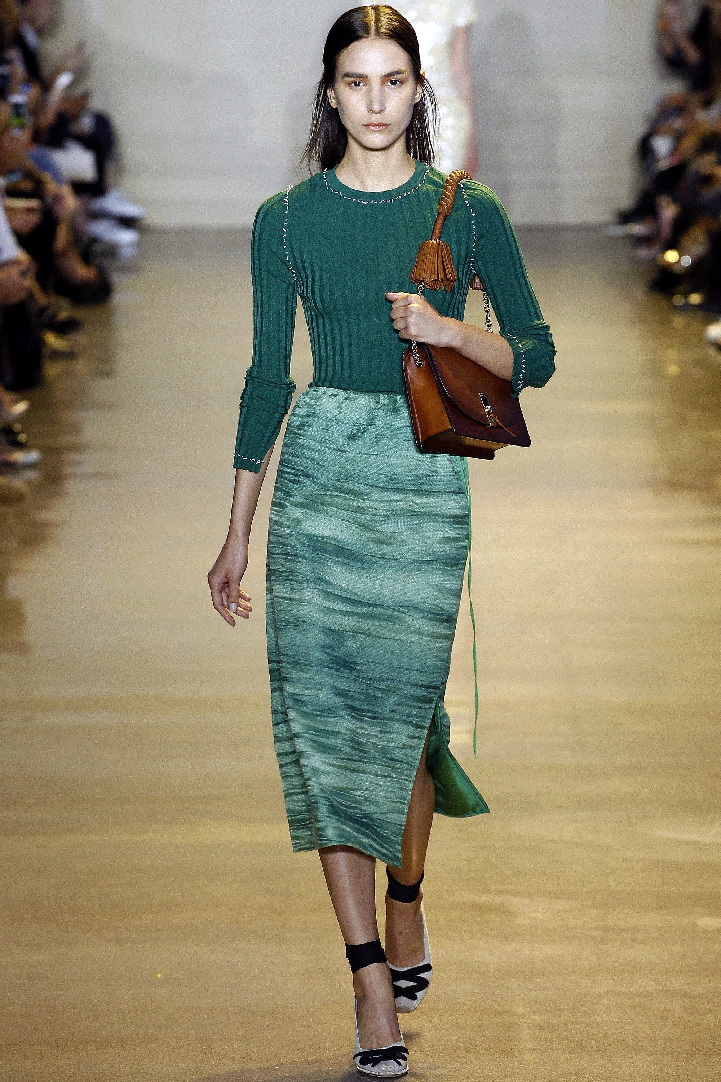
>60% of a fashion show image are pixels that are not clothes
Other Models
Spectators
Stage and General Background
Model Skin and Hair
Notes:
Altuzarra_Spring 2016 Ready-to-Wear_Look 12

Slide 8
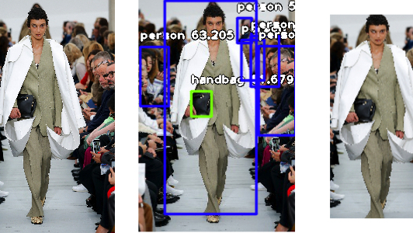
Isolating Clothing Step 1: Isolate Fashion Model Using Tensor Flow
Notes:
Celine Spring 2018 Ready to Wear – Look 1

Slide 9
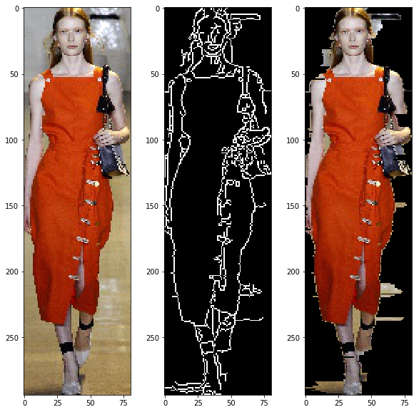
Isolating Clothing Step 2: Remove Background Using Canny Edge Detection

Slide 10
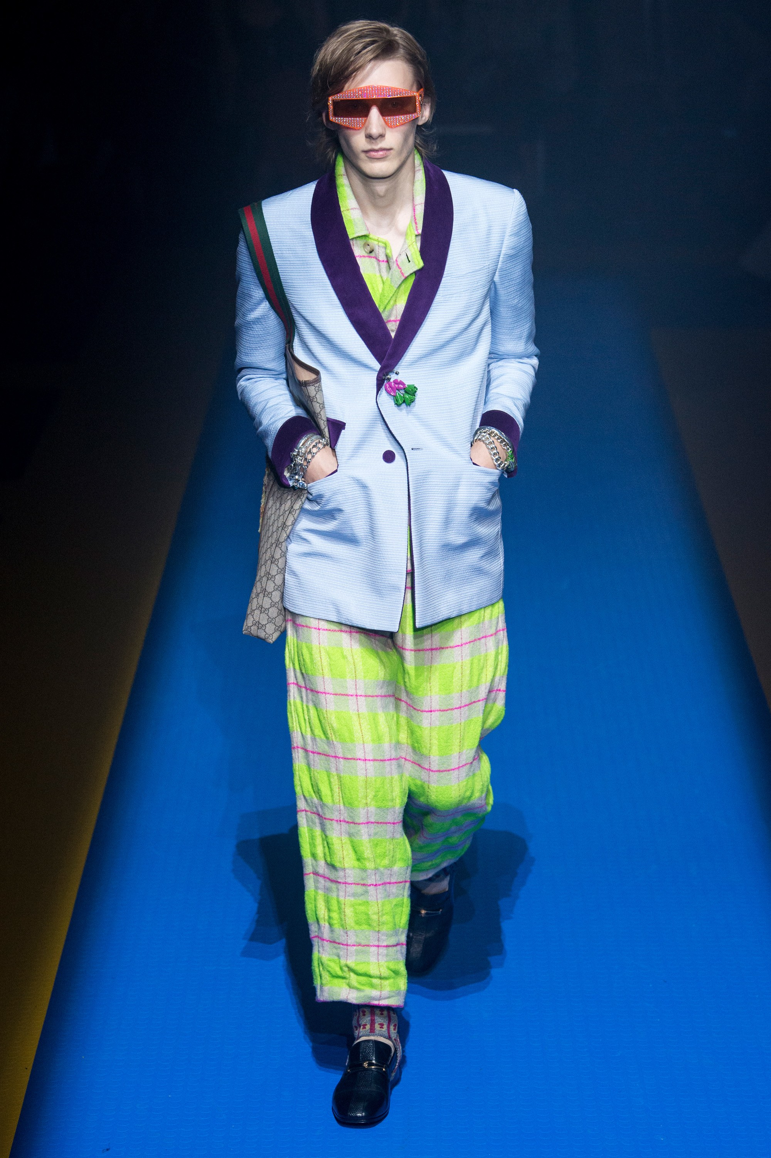
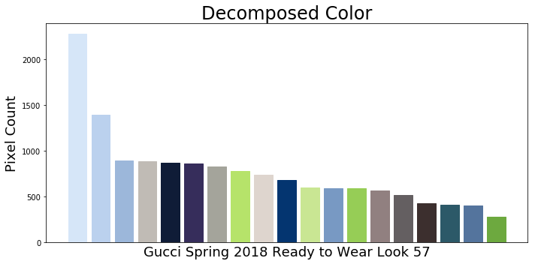
Extracting Color: K-Means Clustering to reduce images to 20 colors
Notes:
Gucci Spring 2018 Ready to Wear Look 57

Slide 11
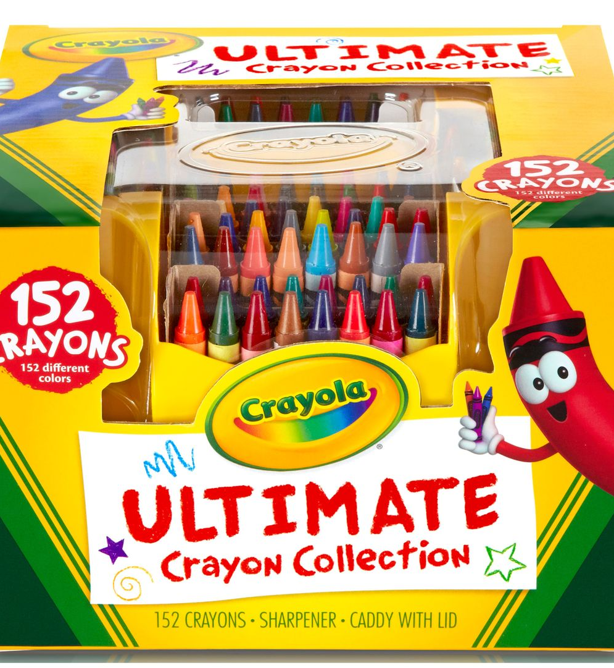
Naming Colors: A non-trivial task
Even w/ clustering, there are millions of possible RGB colors
Color name is subjective, but nuance extremely important in the fashion world
Chose 152 colors from XKCD Color Survey, A number chosen entirely based on Crayola's biggest box of crayons

Slide 12
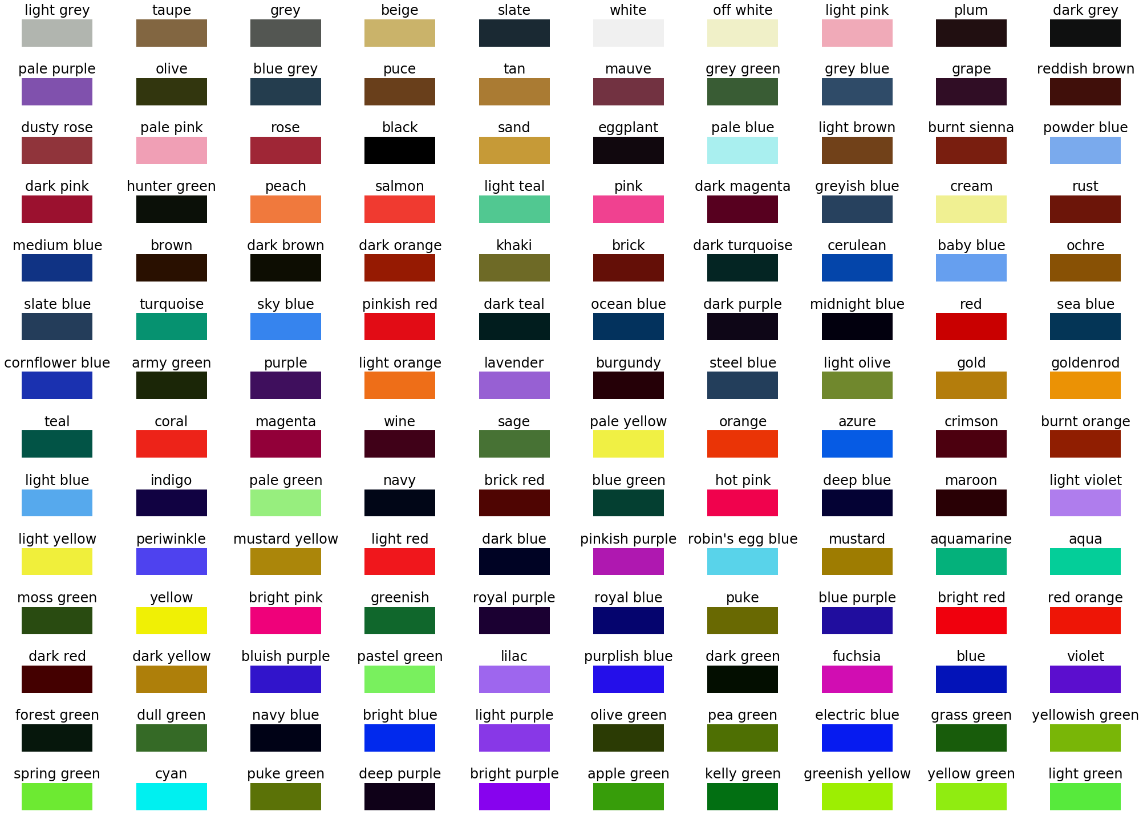
Here is my bag of Colors
You might notice there are only 140 colors here… After my algorithm was matched, only 140 of the 152 colors in my color dictionary had pixel clusters mapped to it

Slide 13
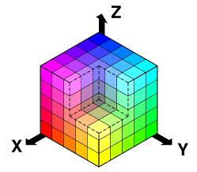
Mapping Colors
By treating the RGB space as a cube, can map a cluster using the Pythagorean Theorem to it’s closest color

Slide 14
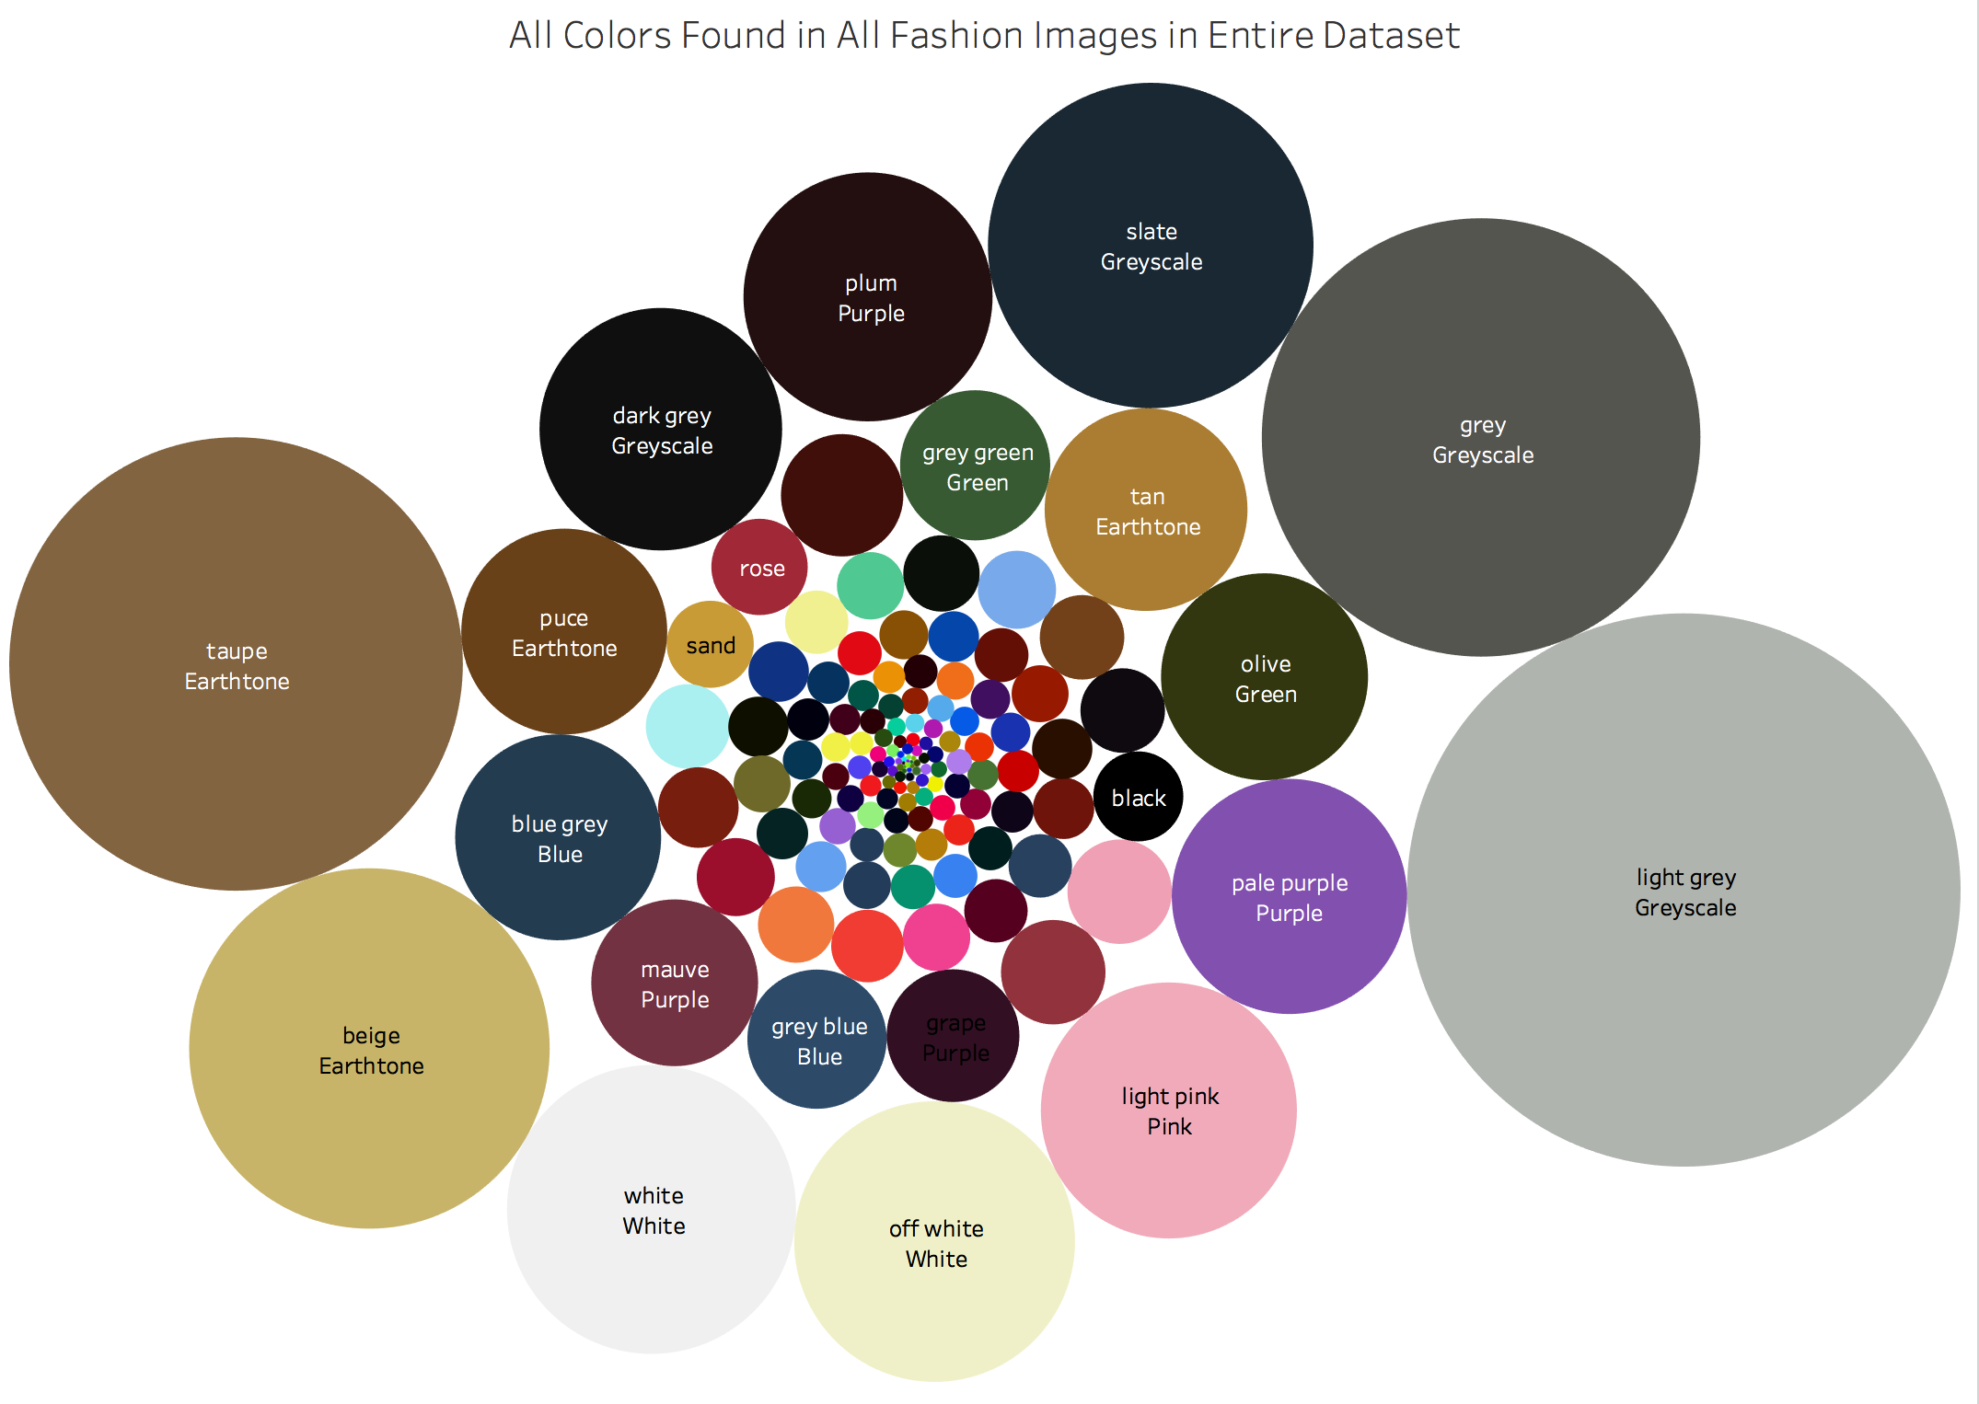
Visualizing Color
Create a new Palette in Tableau
Radius is frequency of occurance
Boring Colors are biggest

Slide 15
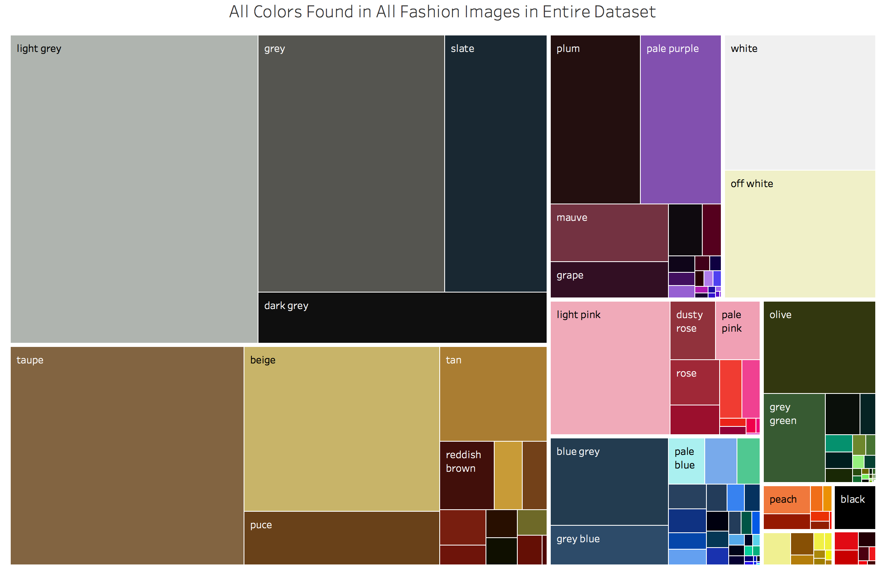
Visualizing Color
Treemaps are normally used for stock portfolios.
Grouping colors by hue is like grouping by industry
Area represents color Frequency

Slide 16
How To Develop Intuition? Enter Data Science
Used Logistic Regression to predict designers based on colors.
Optimize the model and extract coefficients
Assume higher coefficients are considered “defining” characteristic for designer
Used the same technique to predict show, and season

Slide 17
Predicting Designer – Season included
The fact this model predicts anything is surprising
Moschino (80% accuracy) and Christian Dior (50% accuracy) standout, but only participate in Resort Shows

Slide 18
Predicting Designer – Season excluded
With Only Color 205W39NYC Stands Out (33% Accuracy) and Marc Jacobs (25% accuracy)
Notes:
precision recall f1-score support Alexander McQueen 0.15 0.23 0.18 1245 Altuzarra 0.13 0.02 0.04 1245 Balenciaga 0.15 0.05 0.07 1245 Bottega Veneta 0.13 0.36 0.19 1245 Burberry 0.21 0.09 0.13 1245 CALVIN KLEIN 205W39NYC 0.33 0.30 0.32 1245 Calvin Klein Collection 0.15 0.55 0.23 1245 Chanel 0.18 0.06 0.09 1245 Christian Dior 0.12 0.04 0.06 1245 Creatures of the Wind 0.20 0.37 0.26 1245 Céline 0.19 0.20 0.19 1245 Erdem 0.25 0.17 0.21 1245 Gucci 0.25 0.22 0.24 1245 Jacquemus 0.10 0.15 0.12 1245 Koché 0.24 0.12 0.16 1245 Loewe 0.18 0.22 0.20 1245 Louis Vuitton 0.08 0.04 0.05 1245 Marc Jacobs 0.25 0.27 0.26 1245 Moschino 0.27 0.24 0.25 1245 Prada 0.29 0.10 0.15 1245 Saint Laurent 0.16 0.17 0.17 1245 Valentino 0.14 0.08 0.10 1245 Versace 0.30 0.07 0.12 1245 avg / total 0.19 0.18 0.16 28635

Slide 19
Defining Colors By Brand (as determined by logreg coefficients)

Slide 20
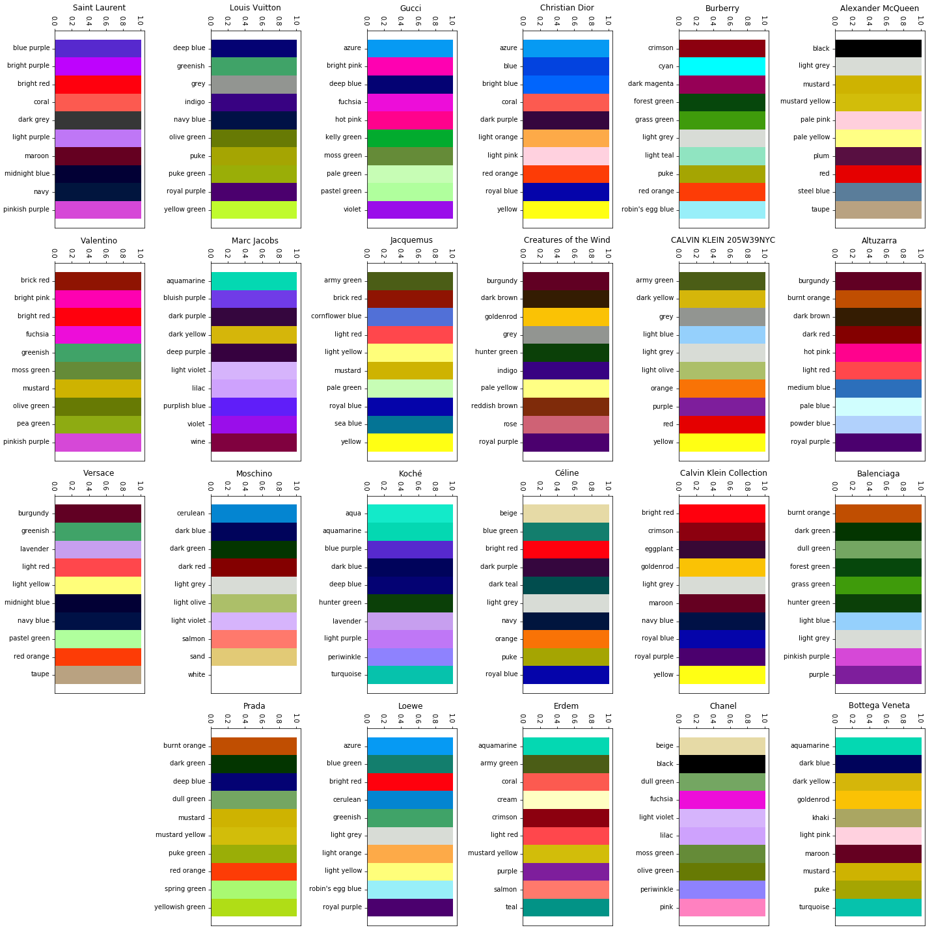
Defining Pallettes by Designer

Slide 21
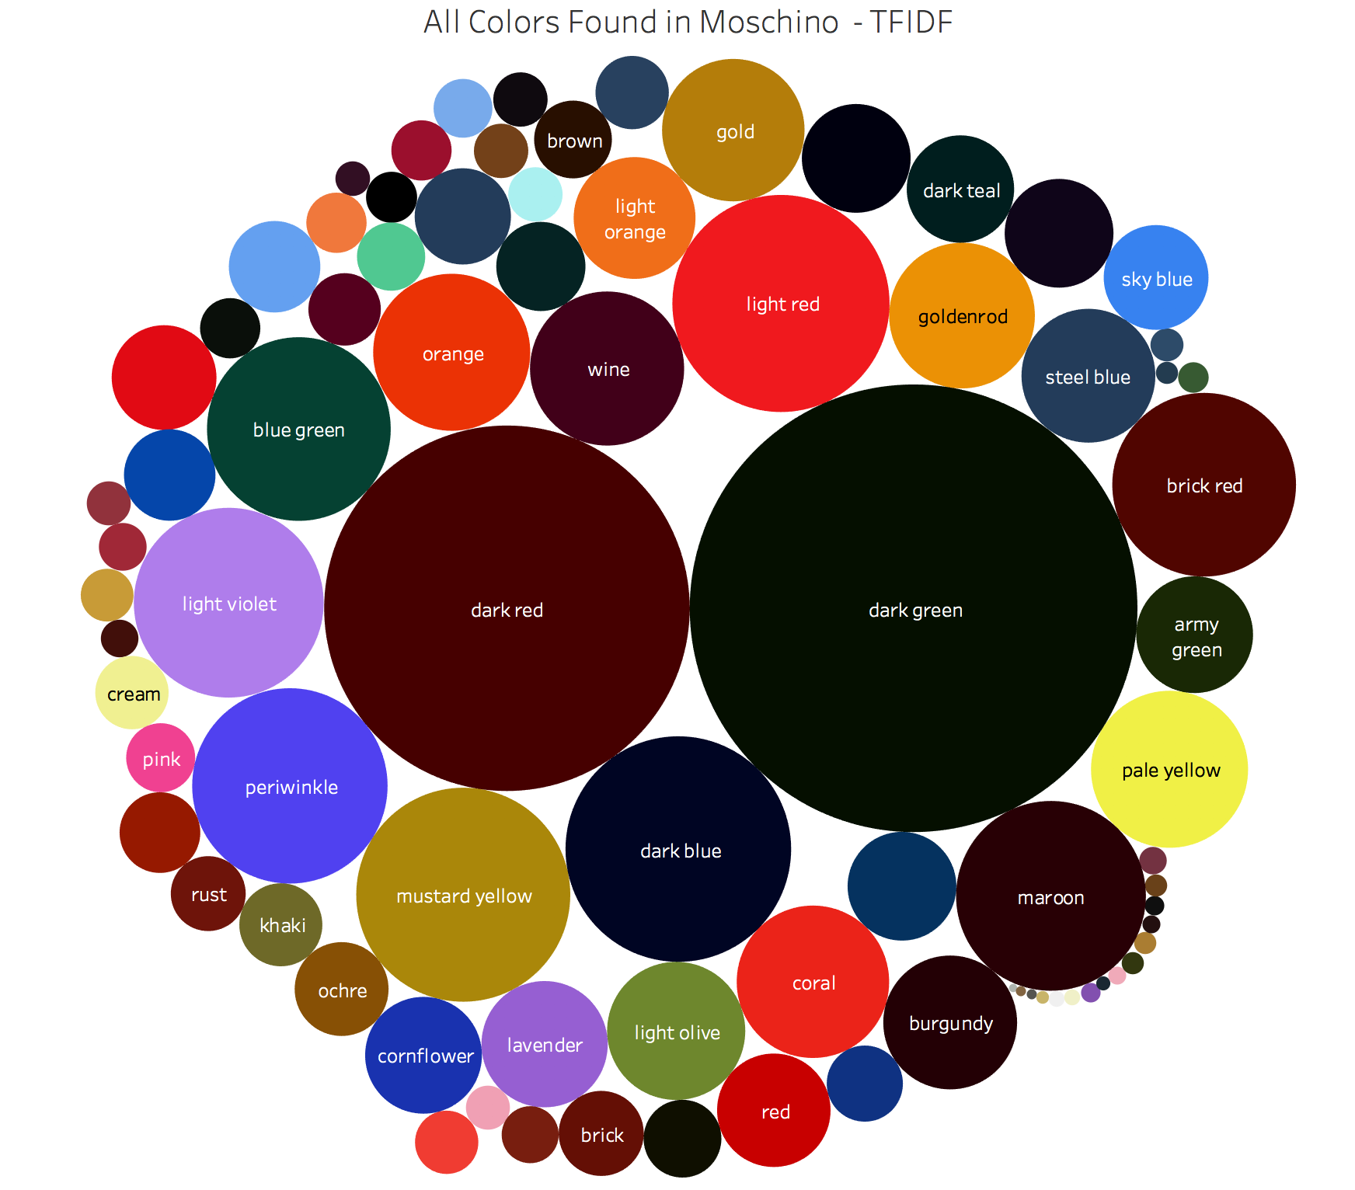
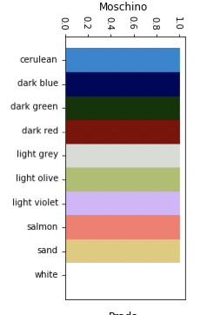
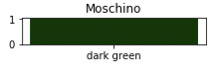
Lets take A look at Moschino TF-IDF
TF-IDF Plot – Gives emphasis to colors rarely used by other designers

Slide 22
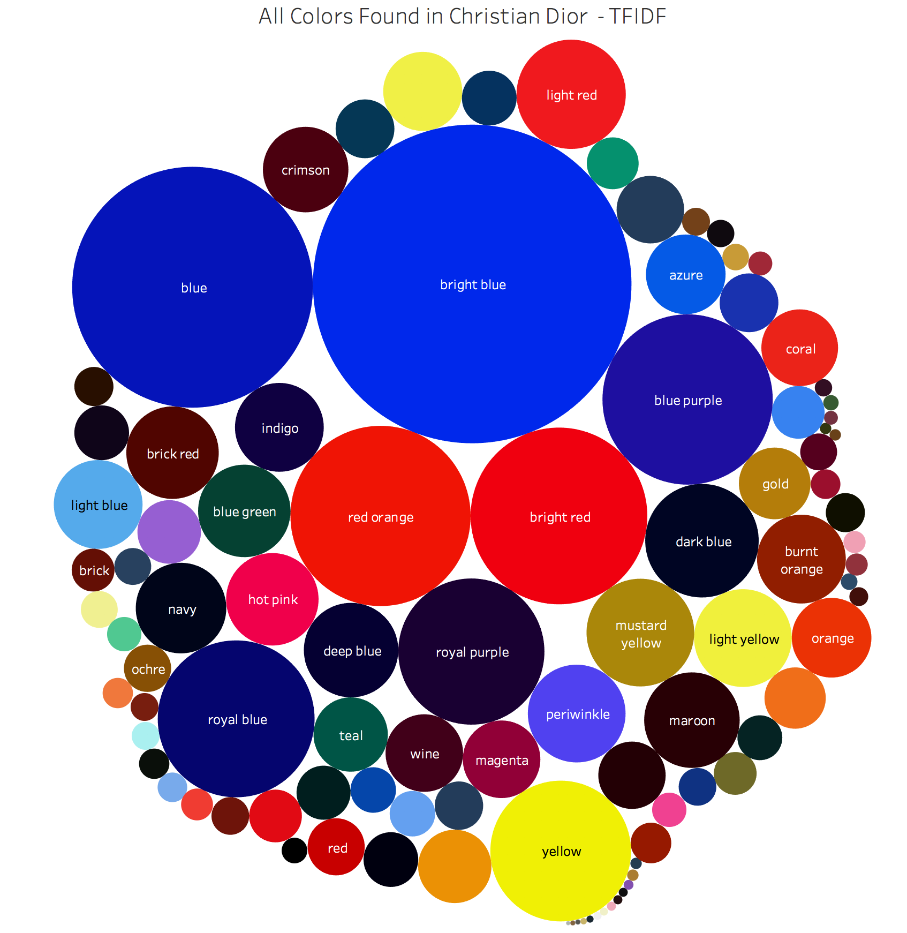
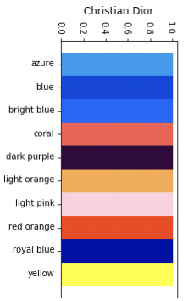
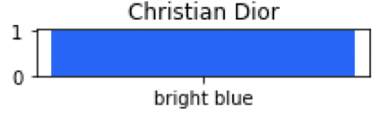
Christian Dior
There appears to be a correlation between TFIDF values and the most defining features as defined by logistic regression.

Slide 23
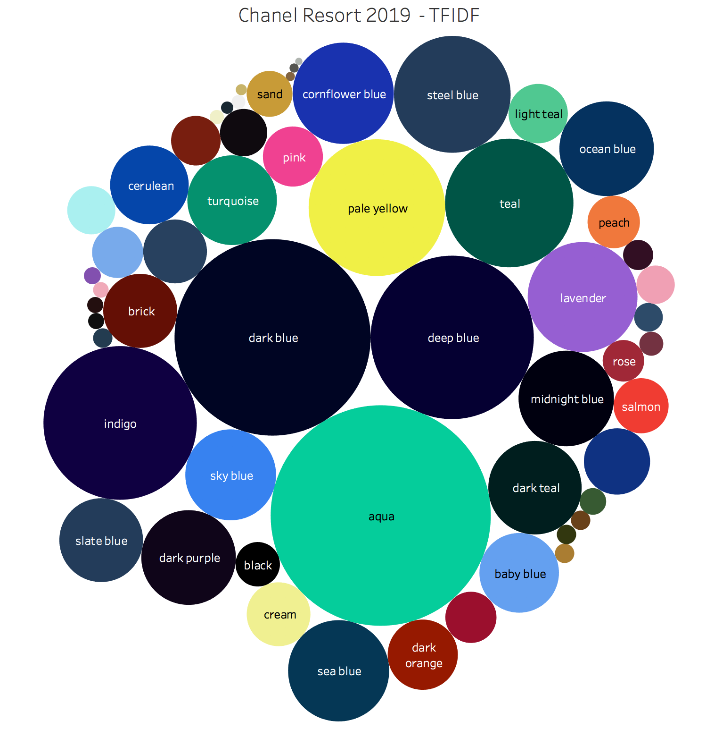
Snapshot of a Show

Slide 24
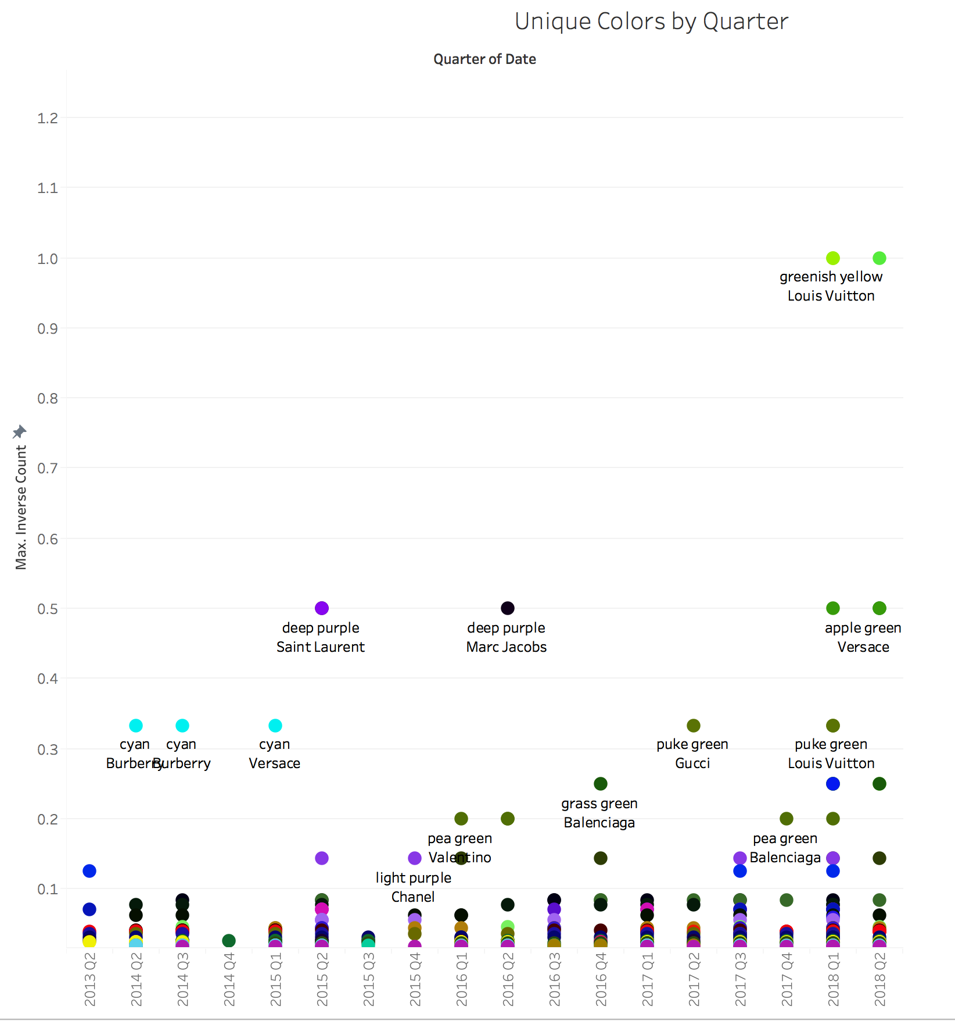
Evidence of Designer ‘s Influencing each other

Slide 25
Finding Similar Styles – Cosine difference
Used a similar recommender system as Netflix,
Movies = Designer, Season, Image
Ratings = Color
Create a distance metric, large numbers are “different” than others, small numbers are “similar” to others.

Slide 26
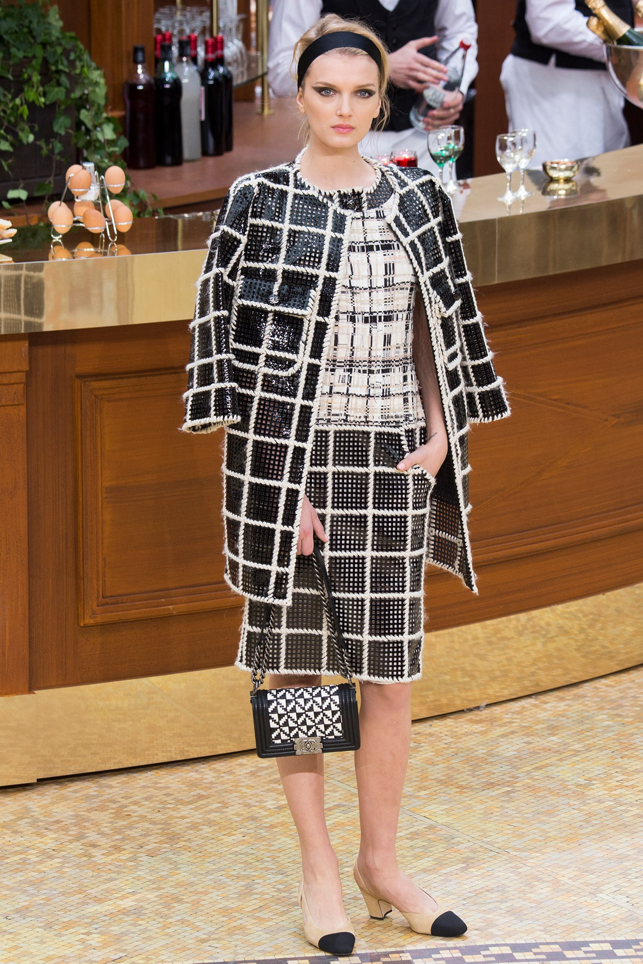
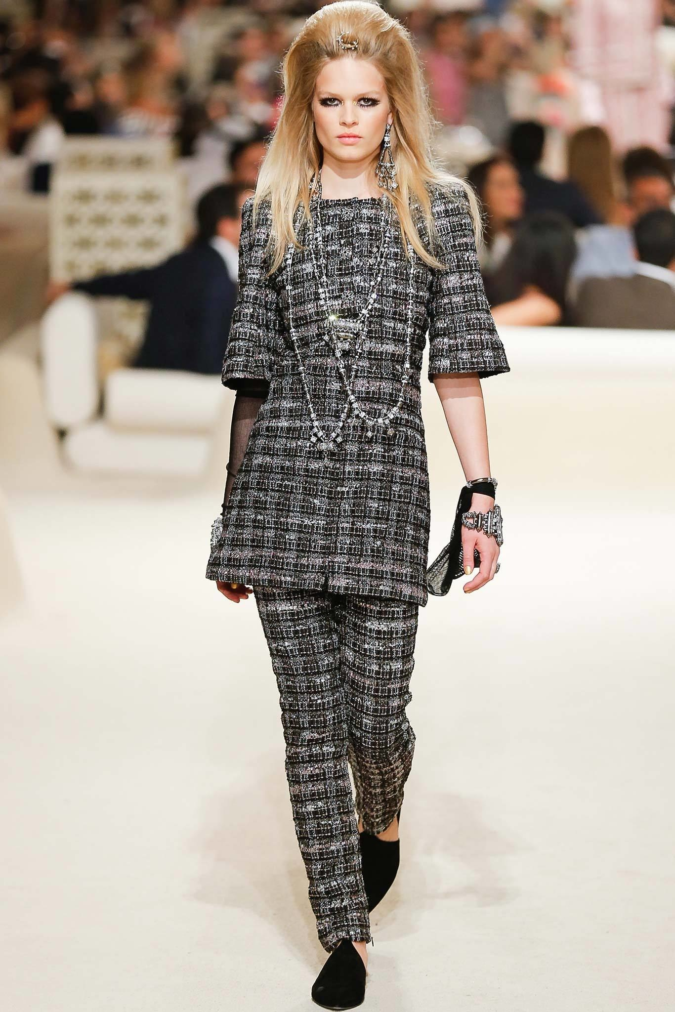
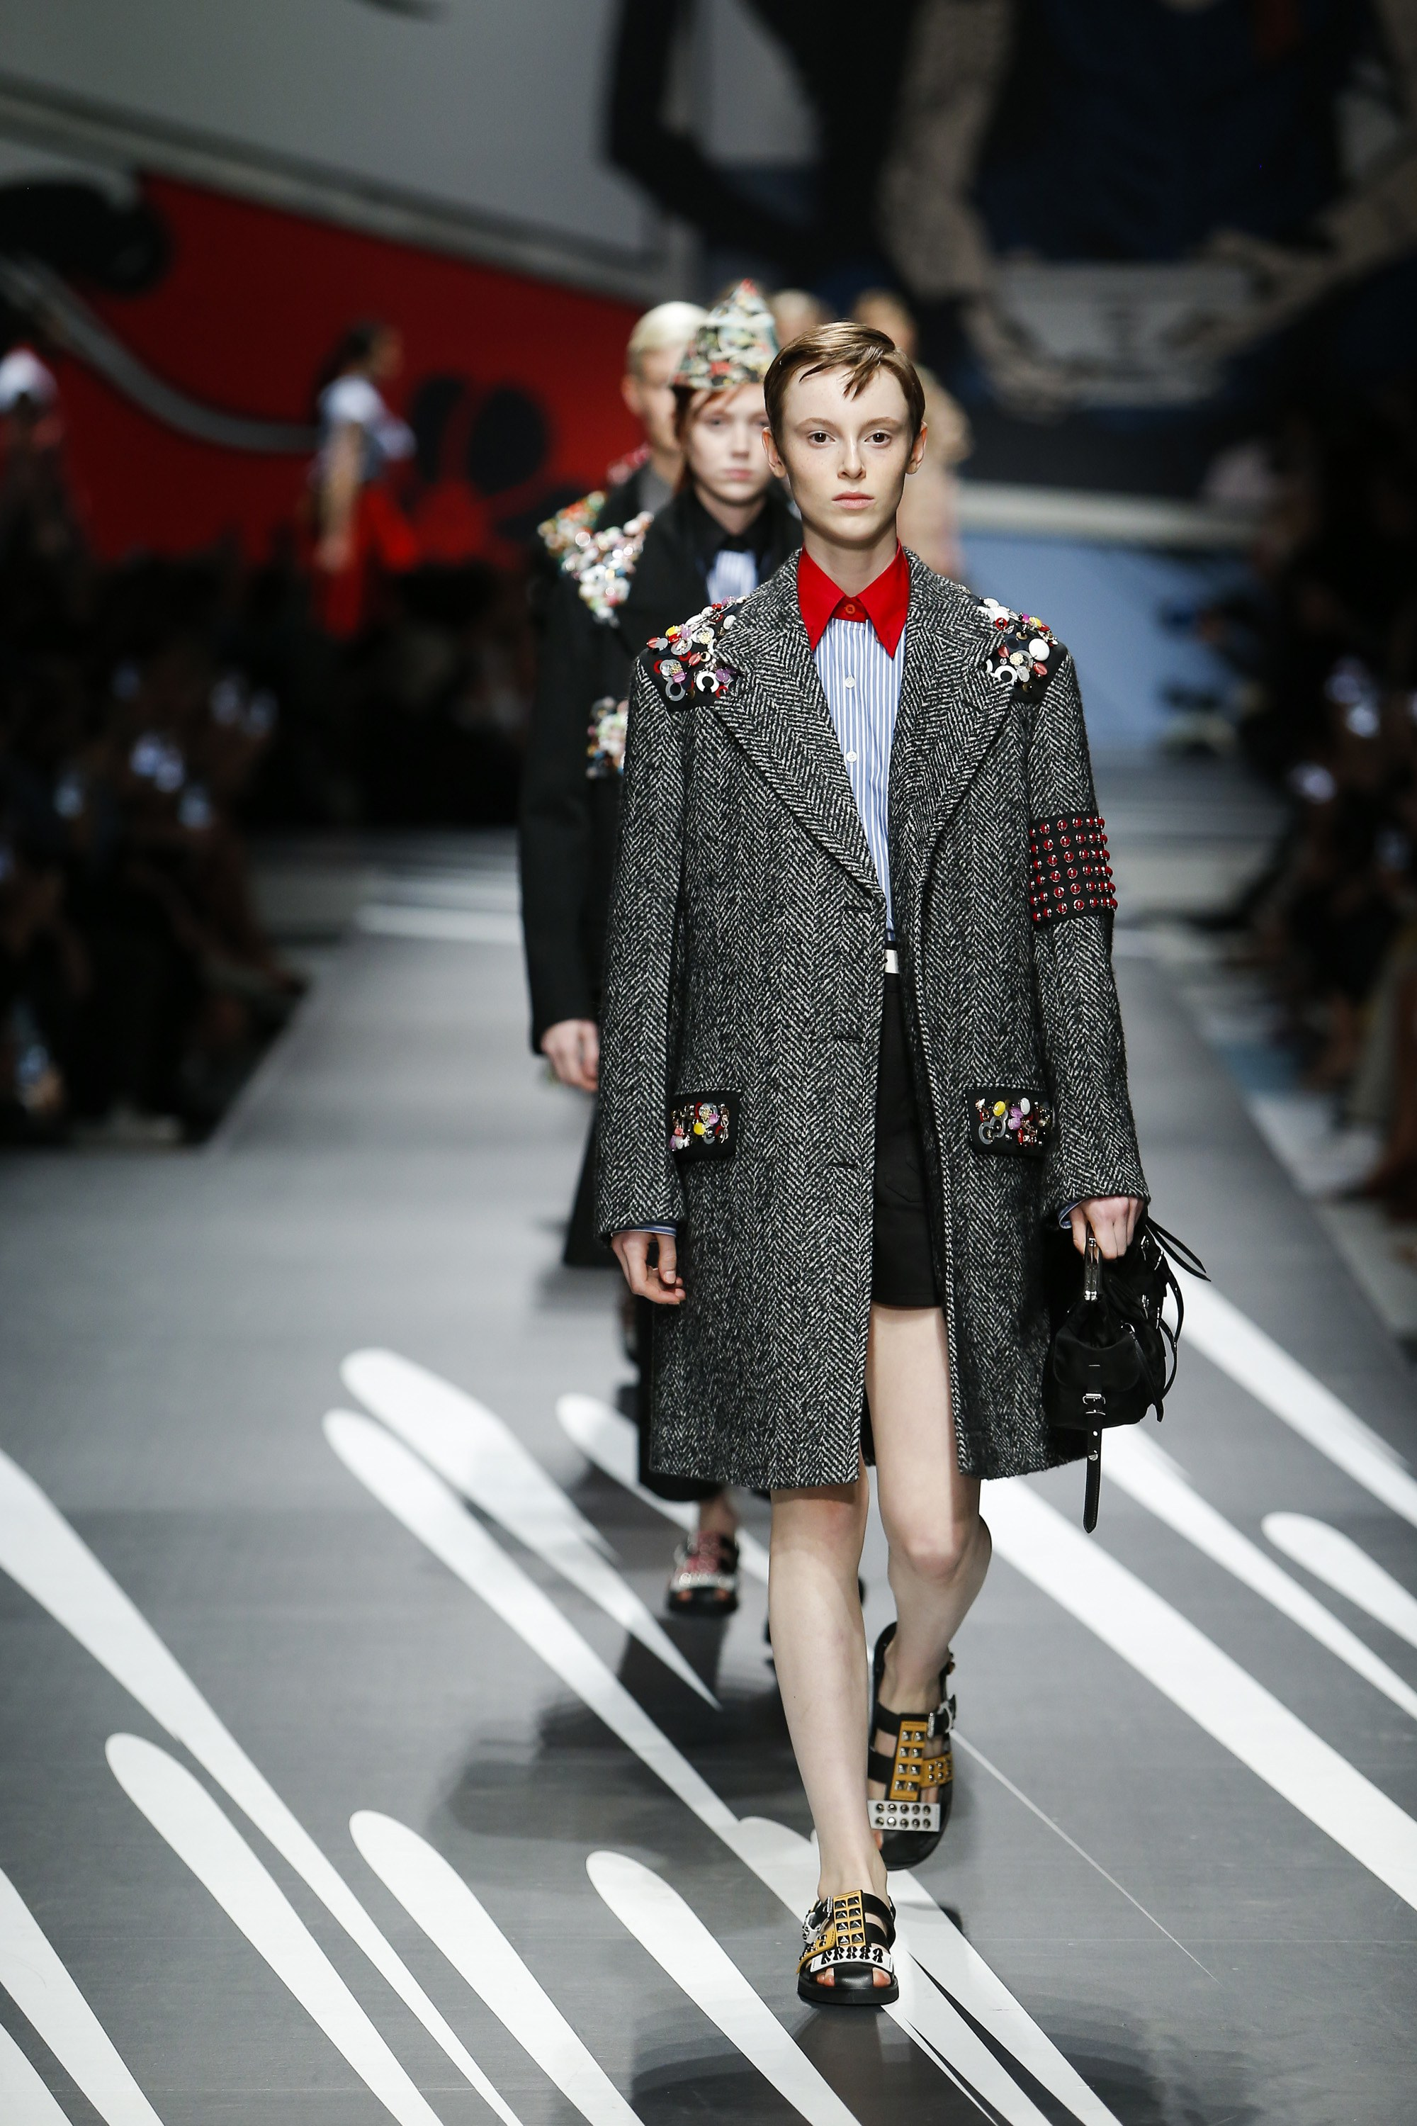
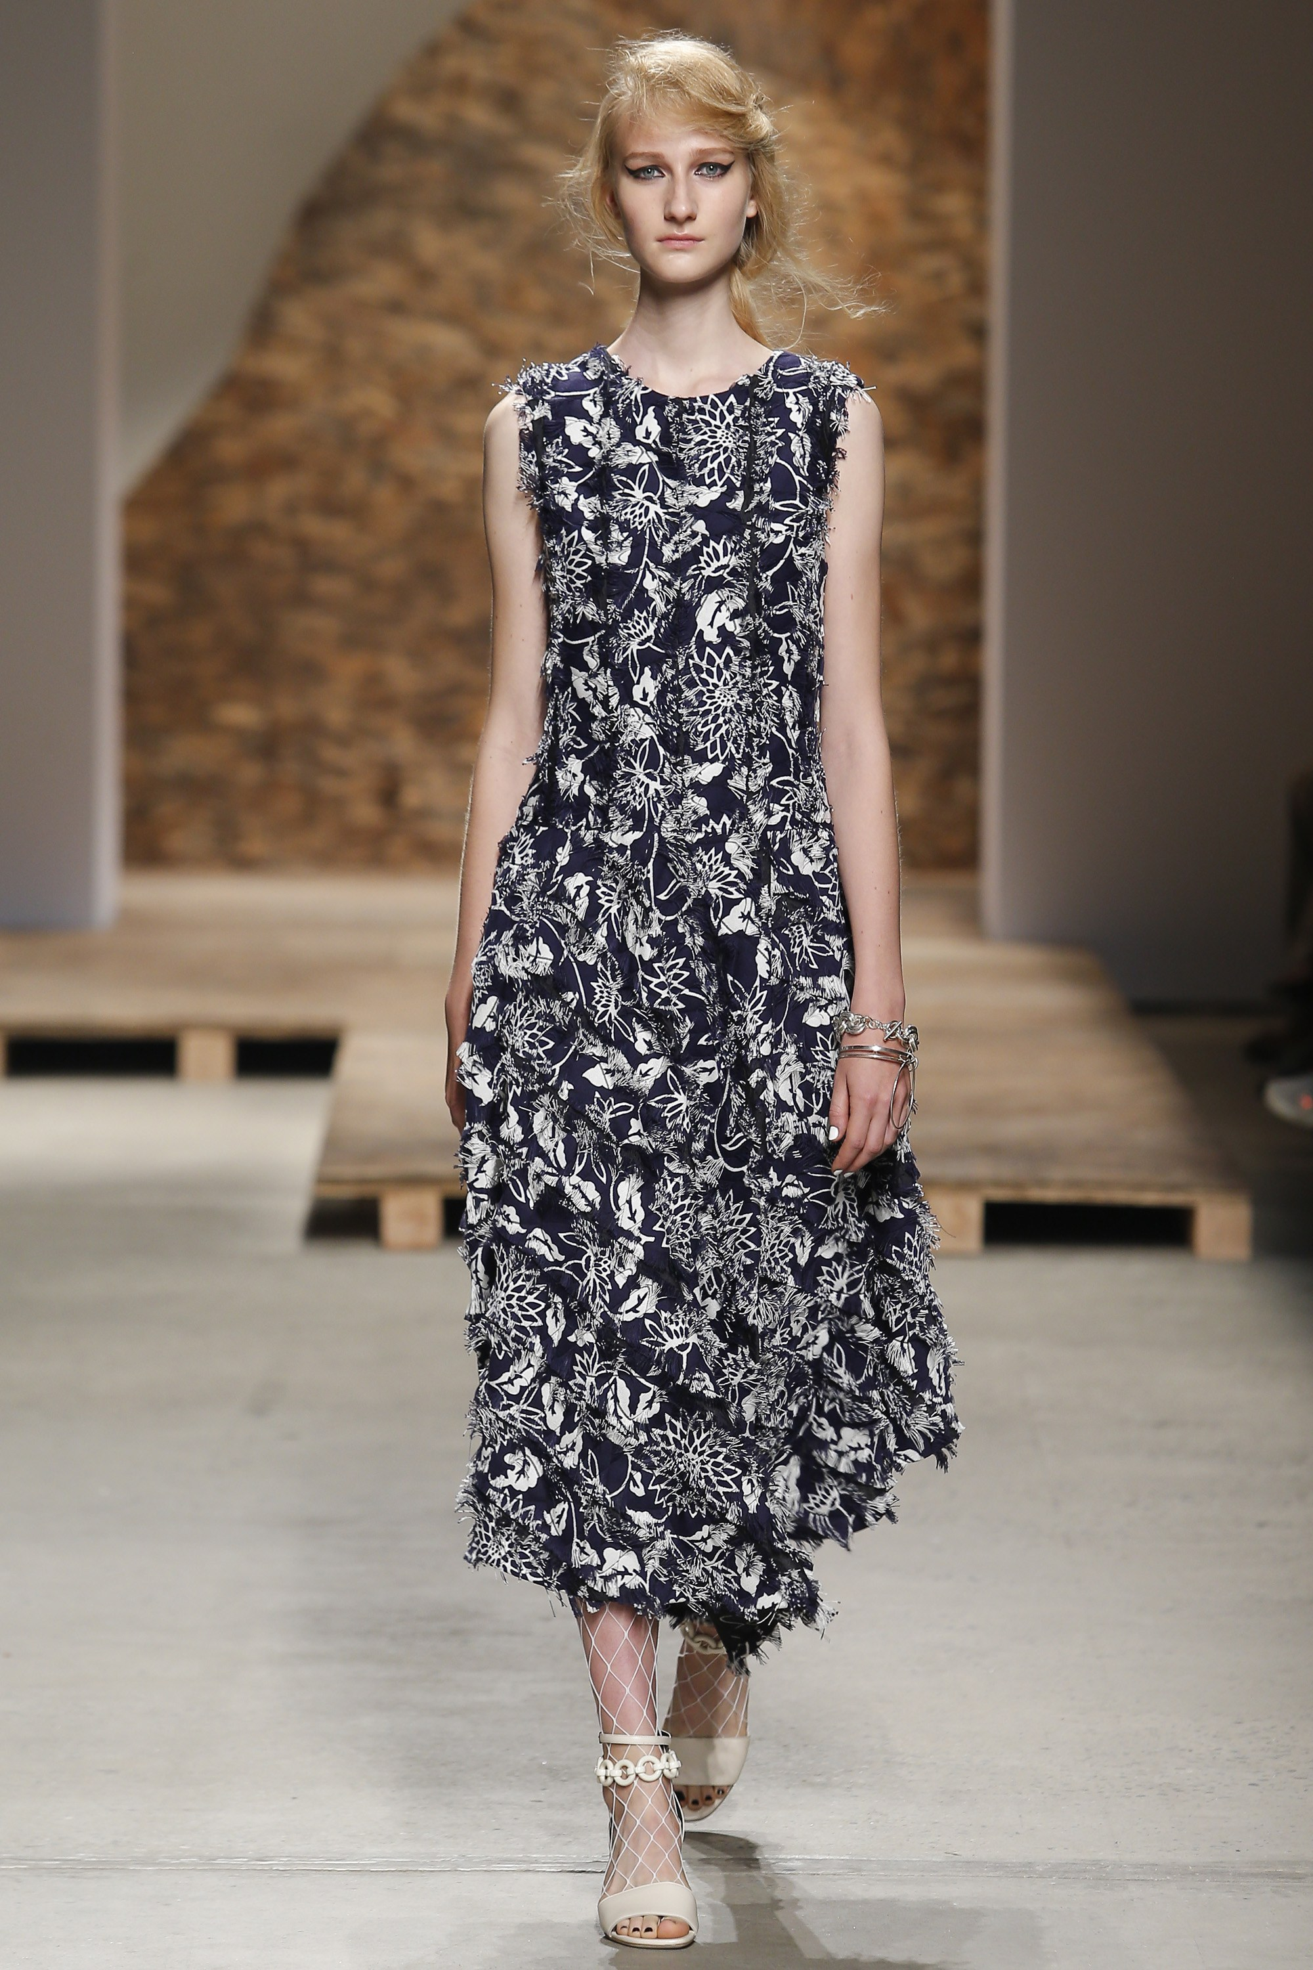
Finding Similar Outfits

Slide 27
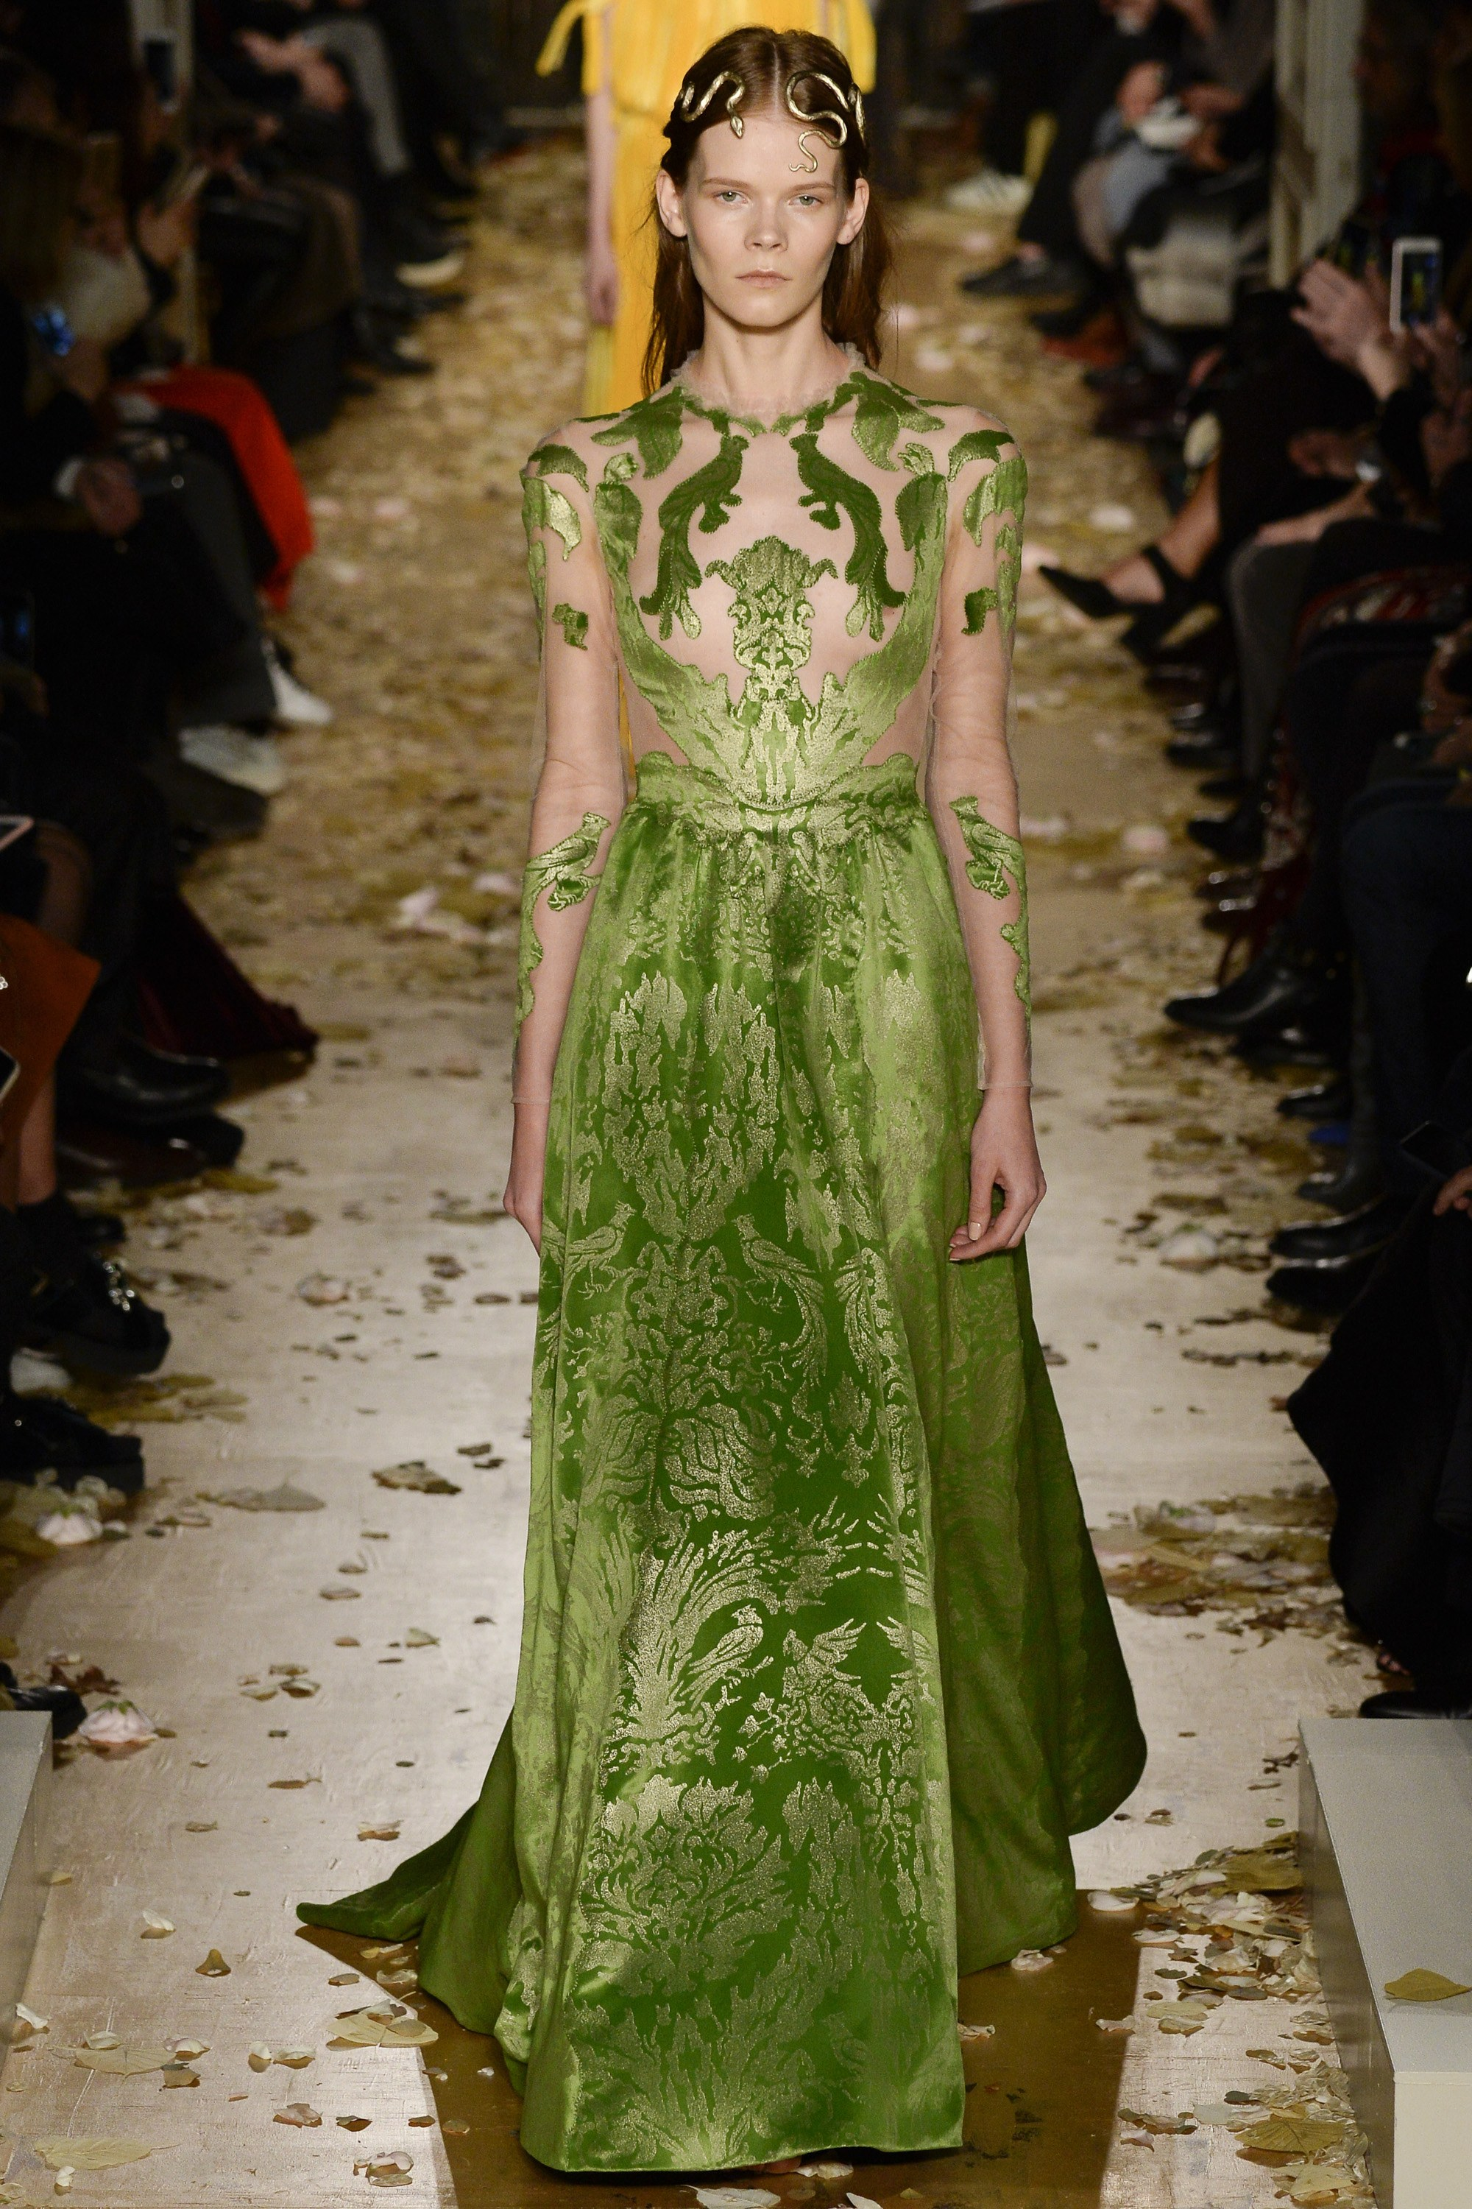
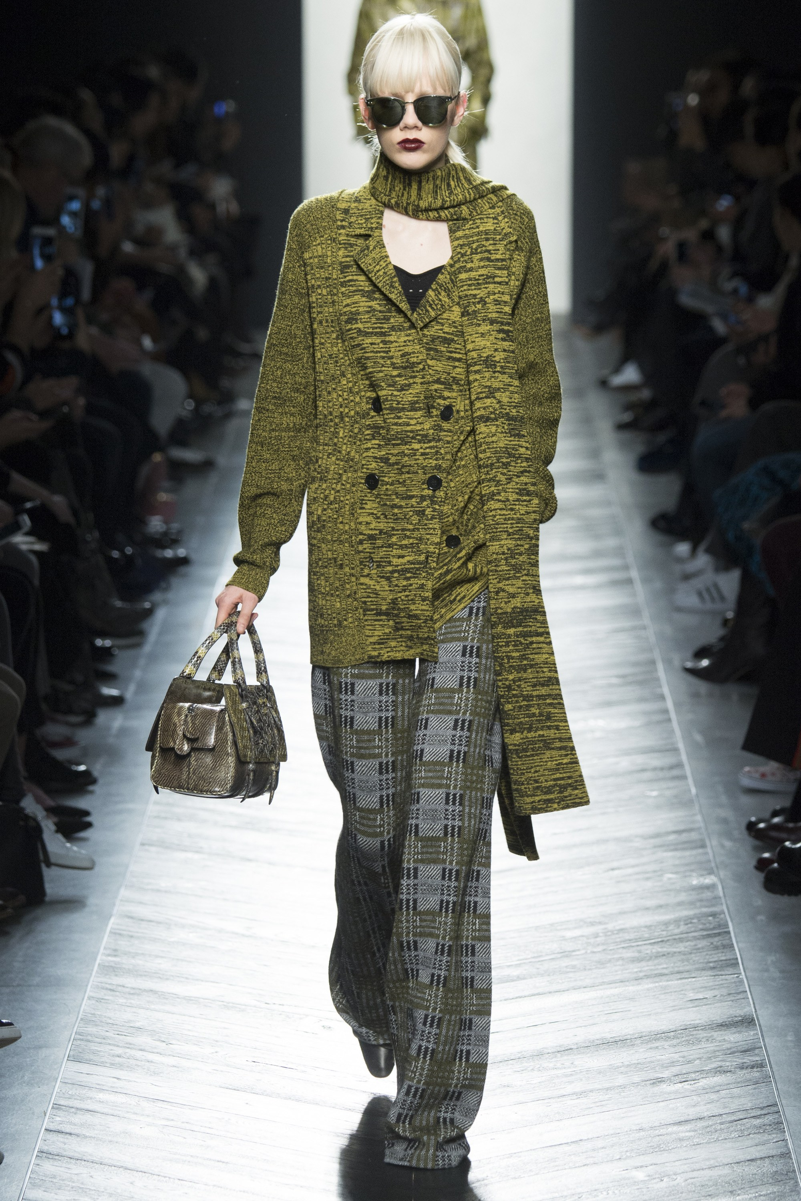
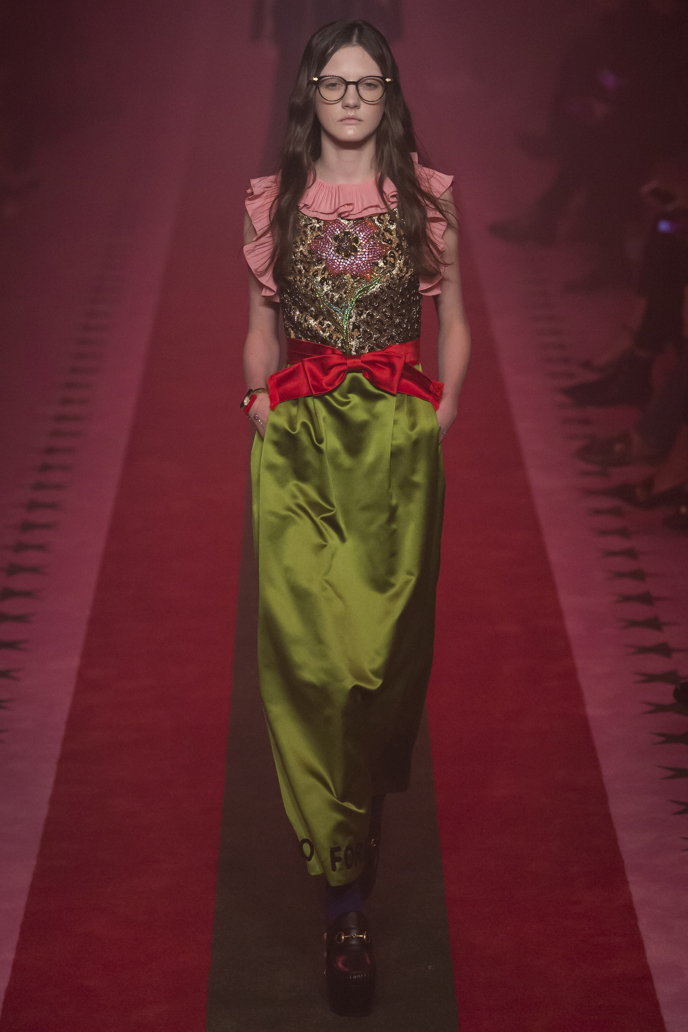
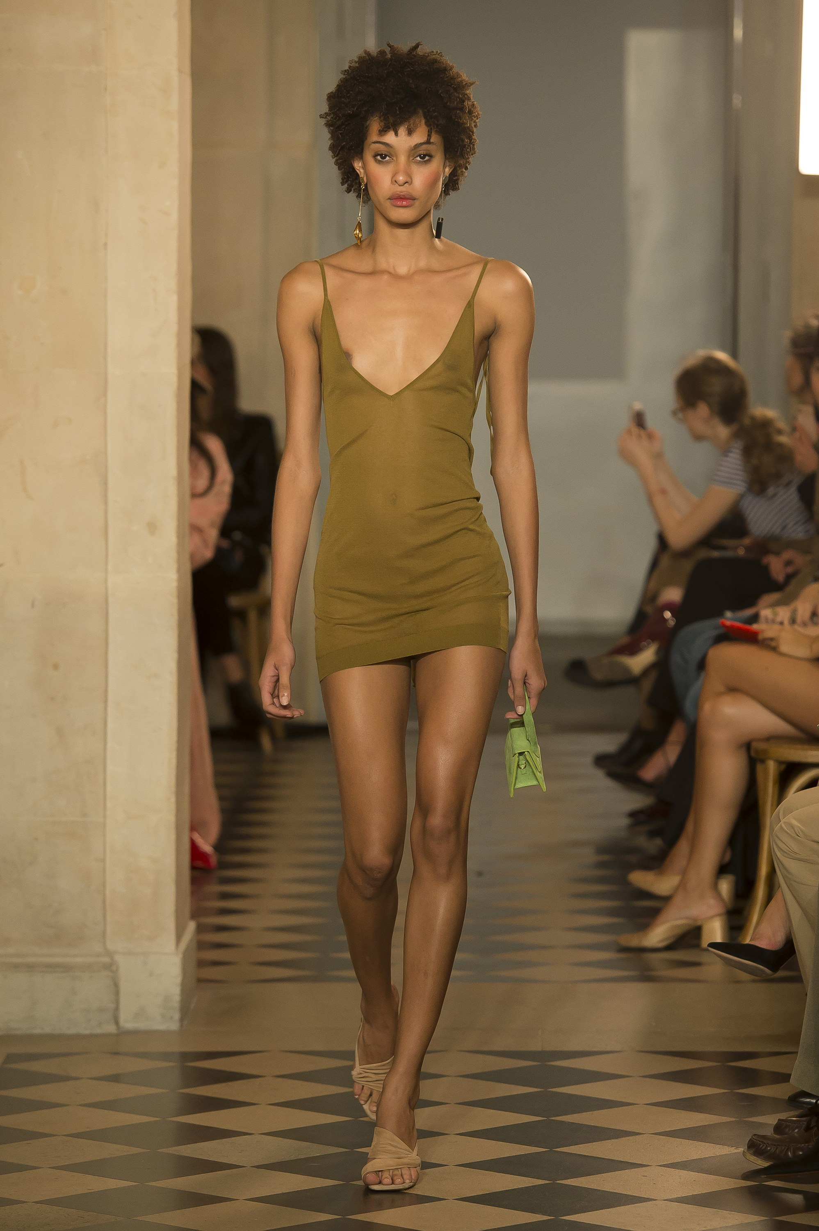
Appearance of Pea Green – Images found via Recommender system
Gucci Spring 2017
Jacquemus Spring 2018
Bottega Veneta Fall 2016
Valentino – Spring 2016
First Appearance
Notes:
Valentino_Spring 2016 Couture_Look 57
Gucci_Spring 2017 Ready-to-Wear_Look 46
Gucci_Spring 2017 Menswear_Look 49
Bottega Veneta_Fall 2016 Ready-to-Wear_Look 10
Jacquemus_Spring 2018 Ready-to-Wear_Look 33

Slide 28
Next Steps
Tensor flow to identify clothing
Solve the skin/clothing confusion problem
Streamline data pipeline
Include more images

